Slide 1

Data Science Guided Capstone Spring board 2022 - Jacinda Garcia

Slide 2
Big Mountain Resort Current Assessment
Current pricing: $81.00
Current basis of pricing: Montana ski resort market averages
Features being considered: Adding a new chair with an operating cost of $1,540,000 for the current season
Strategies proposed by business: Charging a premium above average ticket price and using a data driven approach to better capitalize on the facilities at Big Mountain resort.

Slide 3
Recommendations and Key Findings
Top features
Longest run
Snow Making
Number of runs
Skiable terrain
Vertical drop
Total chairs
Fast quads
Trams
Big Mountain resort should allocate resources into increasing their vertical drop by 150 feet, installing the additional chair lift, and adding 2 acres of snow making. This would support a $9.90 increase in price which amounts to an estimated revenue increase of $17,322,717
The model suggests that the new Big Mountain Resort should be $95.87 with a mean absolute error of $10.39.

Slide 4
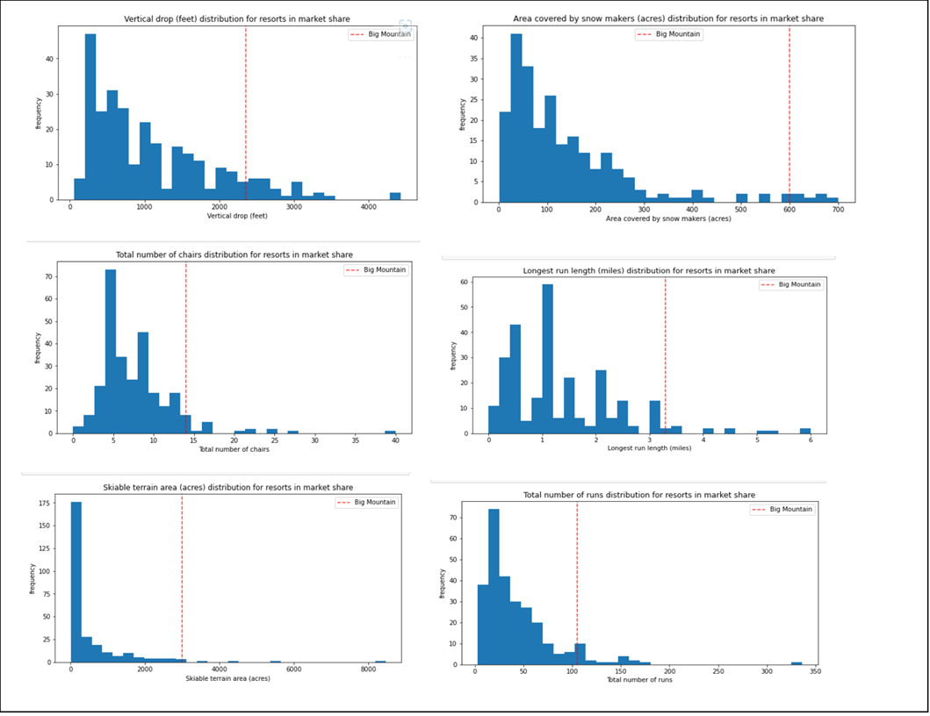
Big Mountain top features vs other resorts
We can see from these figures Big Mountain Resort that it performs in the top for the important features shown.

Slide 5
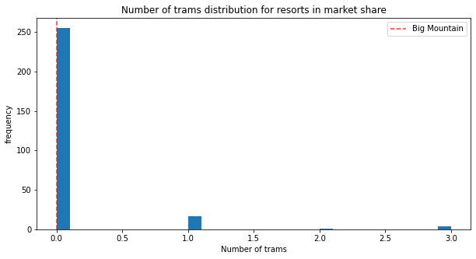
Trams
Big Mountain Resort does fall on the low end of trams, but this is not a factor to focus on in regards to ticket price since many resorts do not have trams.

Slide 6
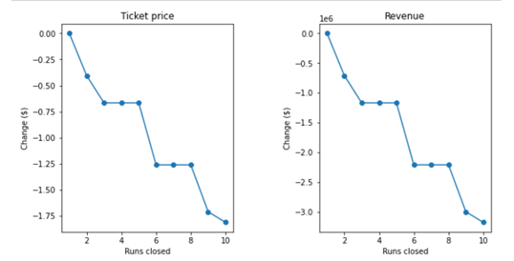
Modeled scenario of runs closed
From this model it is seen that runs closed does not have a significant affect on price. Operation costs of runs is needed to make a better case for closing runs vs keeping them.

Slide 7
Conclusion
Currently Big Mountain Resort’s ticket price is undervalued based on the new model for pricing
It is recommended that Big Mountain moves forward with adding an additional chair lift and increasing the vertical drop by 150 feet.
For future analysis, it would be helpful to have data on operational costs, customer surveys, and other sources of revenue at the resort such as food, lodging, and rentals.

